Slide 1
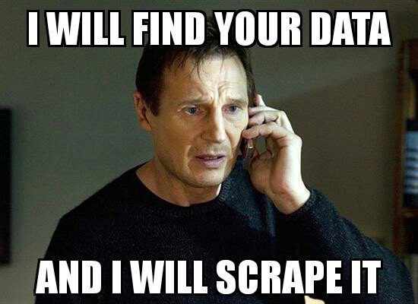
Web Scraping
In our past project, we had only pulled data from two sources for one year
Now we wanted to pull data from three sources for nine years
A scraper was our choice to be able to quickly and easily choose the years we wanted data from

Slide 2
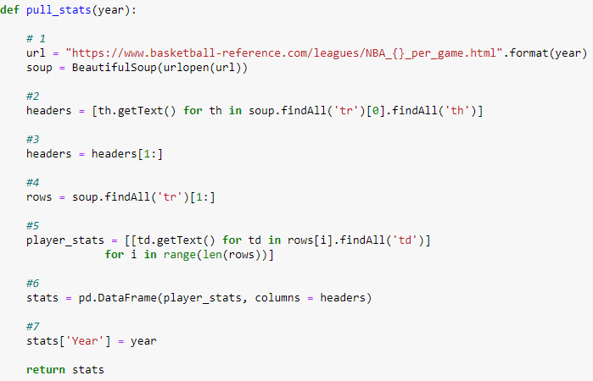
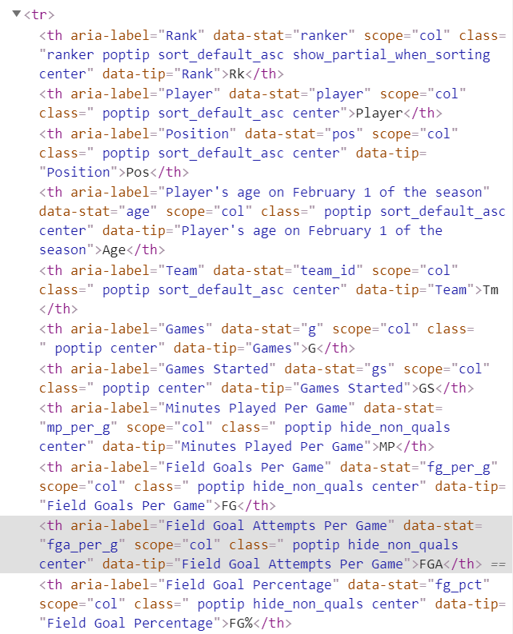
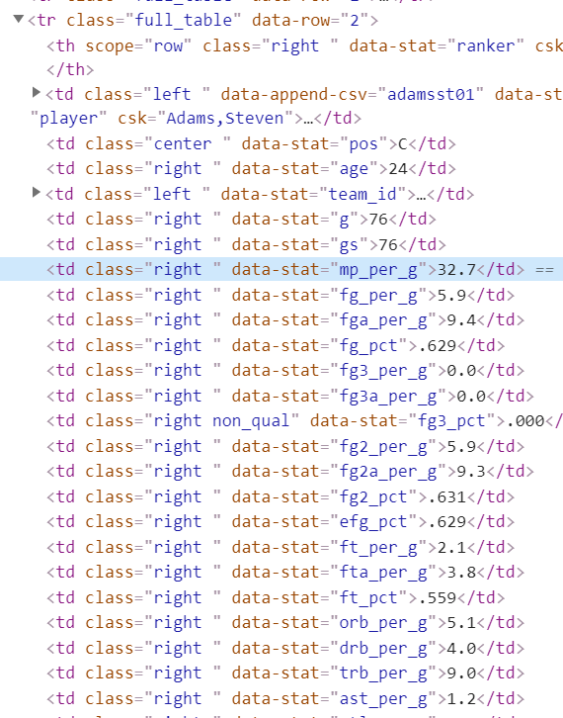
Scraper Part 1
Scraper Code
HTML Section 1
HTLM Section 2

Slide 3
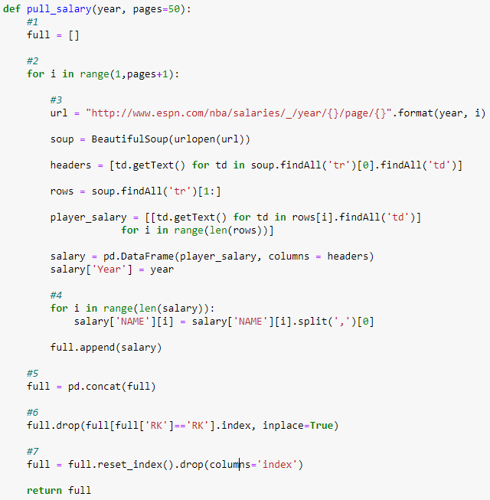
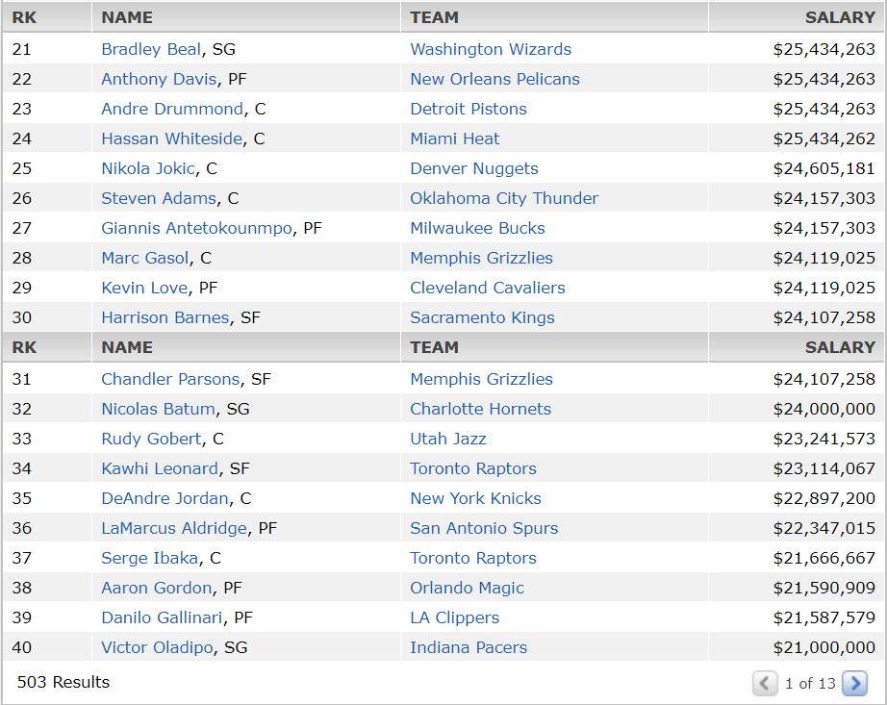
Scraper Part 2
Scraper Code
ESPN website data

Slide 4
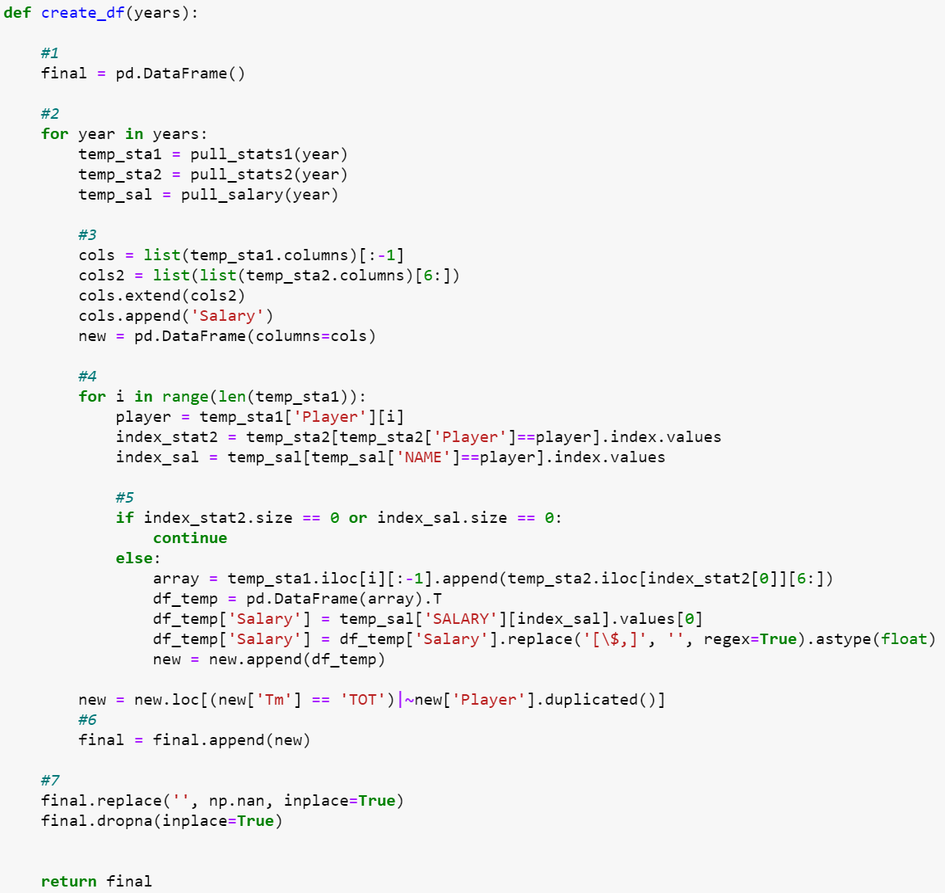
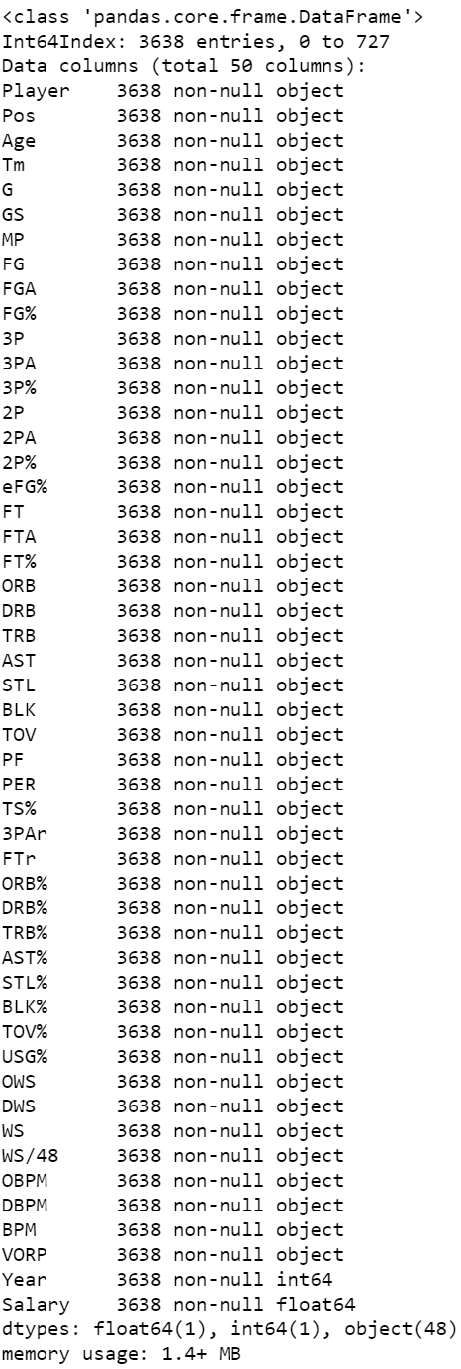
Scraper Part 3
Scraper Code
Dataframe Summary

Slide 5

Previous Project Summary
Background
Previous Model Results
We used five different modeling techniques to determine an optimal model
Ordinary Least Squares (OLS)
Ridge Regression (RR)
Lasso Regression (LR)
ElasticNet Regression (ENR)
Extreme Gradient Boosting Regression (XGBR)
R² and root mean square error (RMSE) values were used to determine model performance
This model was used to predict the 10 most overpaid and 10 most underpaid NBA players
The previous project can be found at our personal GitHub sites:
Taylor Anderson: github.com/TravelingPotato/Portfolio
Jonathan Lawrence: jonathan813.github.io/Portfolio
Jeff Peterson: jdp71.github.io

Slide 6
Model Generalization
What is generalization
Data Preparation
Generalization is a term used to describe a model’s ability to react to new data. That is, after being trained on a training set, a model can digest new data and make accurate predictions. A model’s ability to generalize is central to the success of a model.¹
Data was loaded directly from the web scraper script
2010-2019
Column headers needed to be corrected
Data was separated into 10 dataframes based on Years
Each dataframe was reduced to only the variables of interest
Age, Player Efficiency Rating, Blocks, Turnover Percentage, Steals, Assists Percentage, Games Started, Games Played, Total Rebounds, Field Goals, Defensive Box Plus Minus, Defensive Rebound Percentage, Usage Percentage, and Free Throws.
Source: ¹Generalization and Overfitting. (2017, January 24). Retrieved from https://wp.wwu.edu/machinelearning/2017/01/22/generalization-and-overfitting/

Slide 7
Model Generalization Analysis
What the results mean
Model Results per Year
All of the R² and RMSE values are very similar.
The high R² values indicate that the model generalizes very well with these new datasets.
Interestingly, the last four years show a steady decrease in accuracy

Slide 8
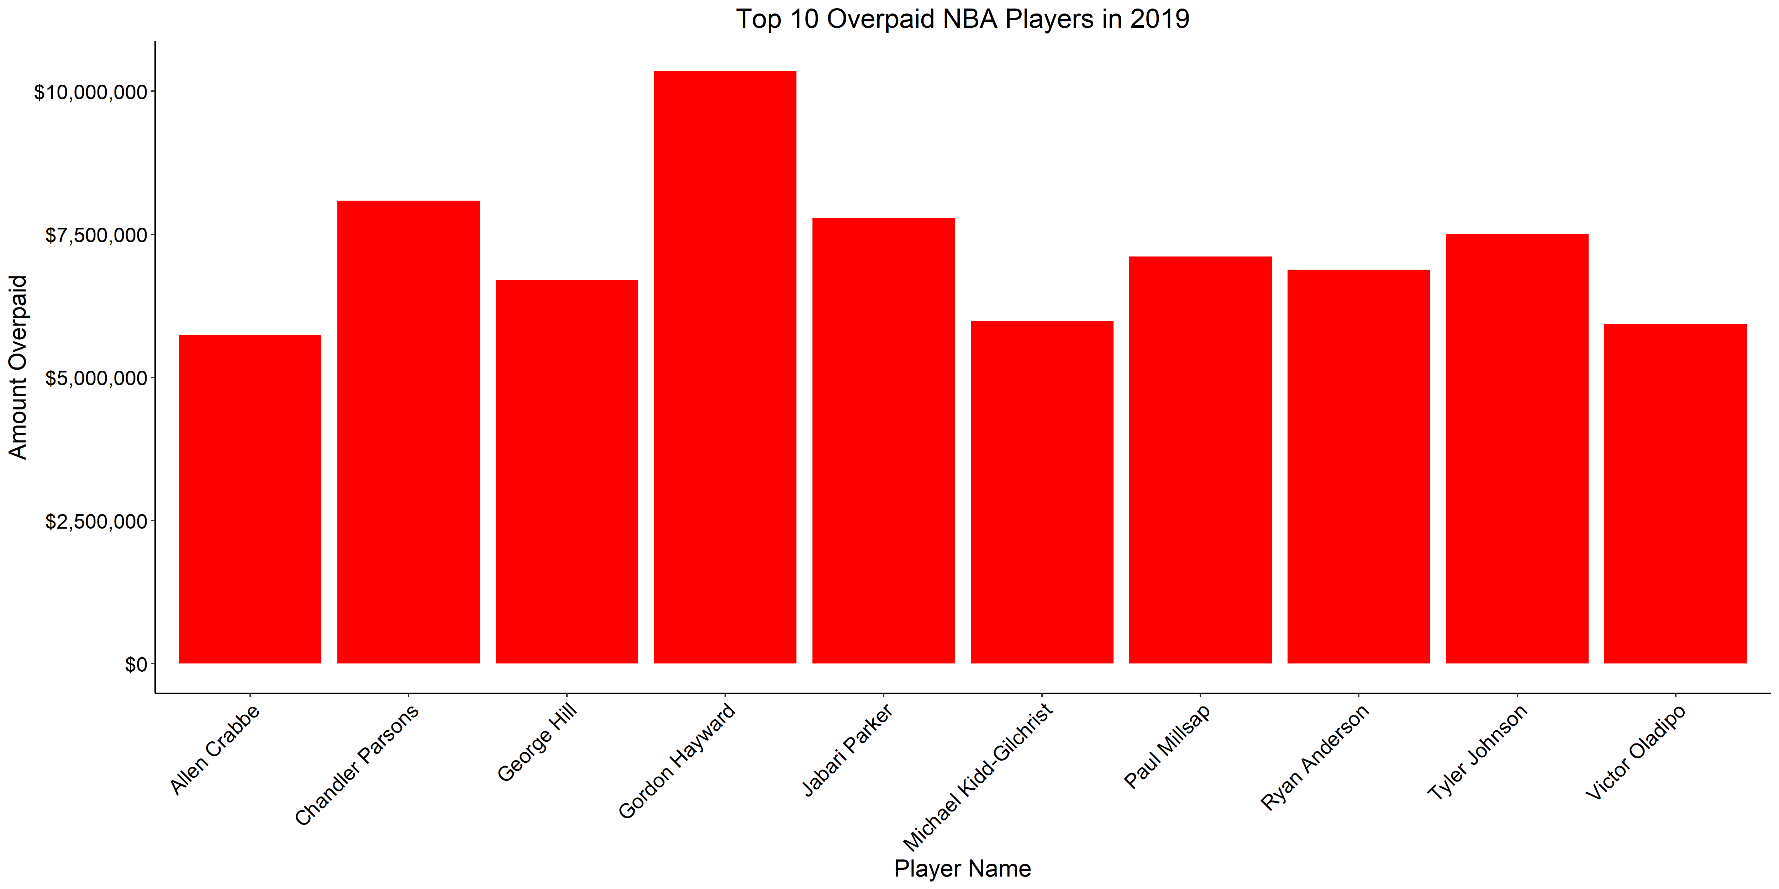
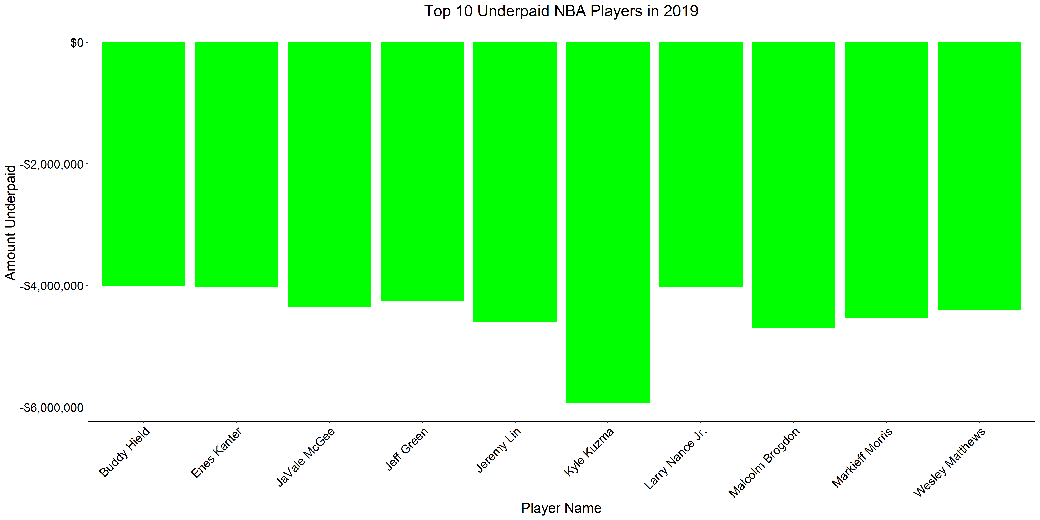
Sample of Top Ten Plots (2019 Data)
Top 10 Overpaid Players
Top 10 Underpaid Players

Slide 9
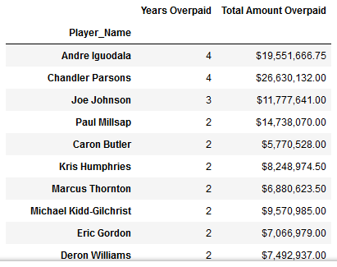
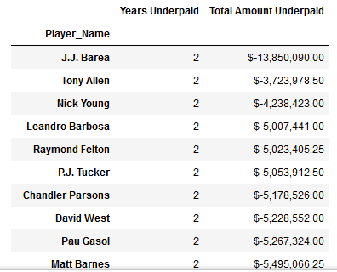
Additional Model Insights
Consistently Overpaid Players
Consistently Underpaid Players

